Slide 1
Prophylactic Responses to the Looming Ontology Chaos
Barry Smith
http://ontology.buffalo.edu/smith

Slide 2
The more ontology is successful, the more it will fail

Slide 3
National Center for Biomedical Ontology
http://bioportal.bioontology.org/
The more we have neat tools like this, the more we will see why chaos looms

Slide 4
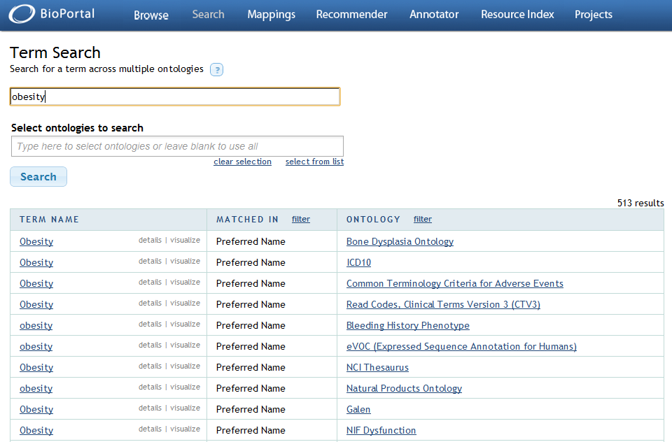

Slide 5
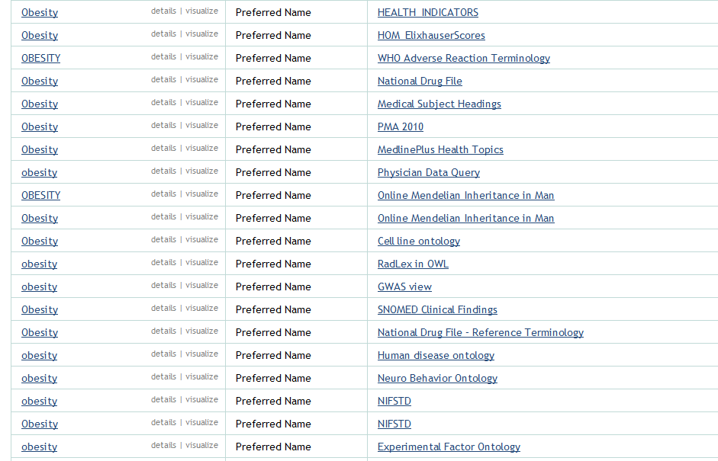

Slide 6
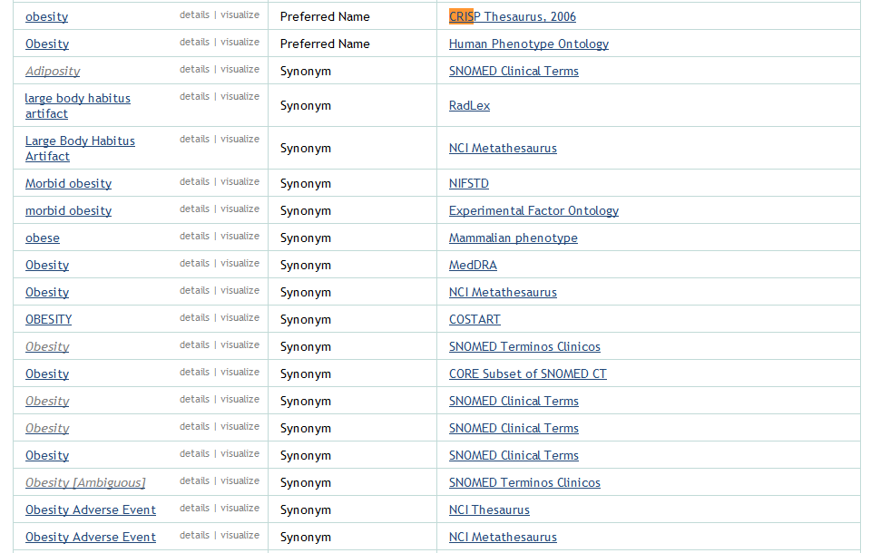
…

Slide 7
National Center for Biomedical Ontology
http://bioportal.bioontology.org/
Ontologies built by biologists
Ontologies built by hackers
Hobby ontologies
Student project ontologies
“I googled the word ‘ontology’ last Tuesdsay” ontologies

Slide 8
1 .Embracing / 2. Resisting
1. Large repositories (million monkeys strategy)
2. Find out what makes ontologies stable and useful, and create an evolutionary process whereby bad ontologies will die

Slide 9
Standards
OWL, CLIF … exist on the syntax (language) side
Standards on the semantics (content) side (top-level ontologies)
Basic Formal Ontology (BFO)
Domain Ontology for Linguistic and Cognitive Engineering (DOLCE)
Suggested Upper Merged Ontology (SUMO)

Slide 10
BFO, DOLCE, SUMO, Cyc
All exist in FOL and OWL versions
All have been tested in use
BFO: very small, truly domain-neutral
DOLCE: extends BFO, but built to support ‘linguistic and cognitive engineering’
SUMO: has its own tiny mathematics, tiny physics, tiny biology (‘body-covering’, ‘fruit-Or-vegetable’), …

Slide 11
~100 ontology projects using BFO
http://www.ifomis.org/bfo/
Open Biomedical Ontologies Foundry
eagle-I, VIVO, CTSAconnect
AstraZeneca
Elsevier
- influence on SNOMED CT
US Departments of Defense and Energy
(Nuclear, Nanotechnology, …)

Slide 12
UK projects using BFO
ChEBI and Emotion Ontology (Janna Hastings, EBI)
RICORDO ontology-based information systems in biomedicine (Pierre Grenon, EBI)
EFO Experimental Factor Ontology (James Malone, EBI)
FlyBase, Gene Ontology, Ontology for Biomedical Investigations (EBI …)
Envo Environment Ontology (Genomic Standards Consortium, Dawn Field, NERC / Oxford)
HCLSIG/PharmaOntology (Colin Batchelor, Royal Society of Chemistry)

Slide 13
How a common upper level ontology can help resist ontology chaos
something to teach
training (expertise) is portable
each new ontology you confront will be more easily understood at the level of content
and more easily criticized, error-checked
provides starting-point for domain-ontology development
provides platform for tool-building and innovations
lessons learned in building and using one ontology can potentially benefit other ontologies
promote shareability of data across discilinary and other boundaries

Slide 14

The Alternative: Infinite Monkey
(Fortuitous Interoperability)Strategy

Slide 15
What language do you use in developing ontologies?
FOL
OWL
OBO
CLIF
English

Slide 16
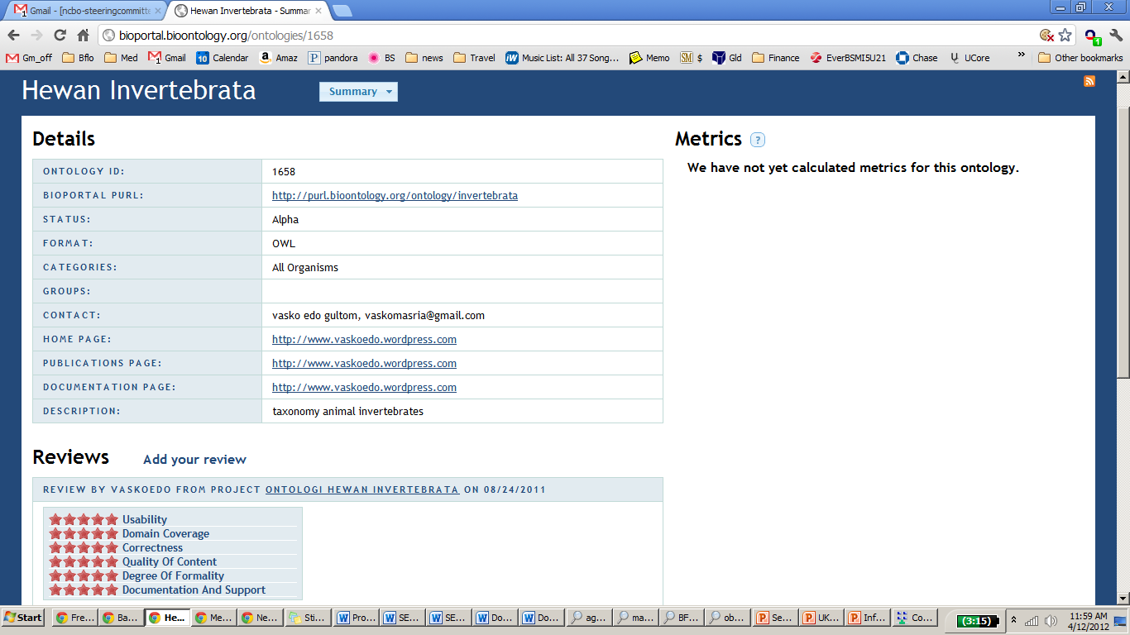
Solve the problem by voting

